Slide 1
Microsoft Teams
usability vs security
Notes:
Zoe
Hi everyone, thanks for having us. We’re here today to talk to you about Microsoft Teams, and the balance between usability and security.

Slide 2






Luke Evans
Technical Architect
Experienced senior technical architect with collaboration driven background
15 years of experience of working with Microsoft collaborative technologies
Has a focus on the technologies that underpin and support collaboration including the wider Microsoft 365 infrastructure, security, identity management and Azure
Worked across a broad range of clients with user bases ranging from 5,000 to 100,000s
Previous Clients
Notes:
Luke

Slide 3
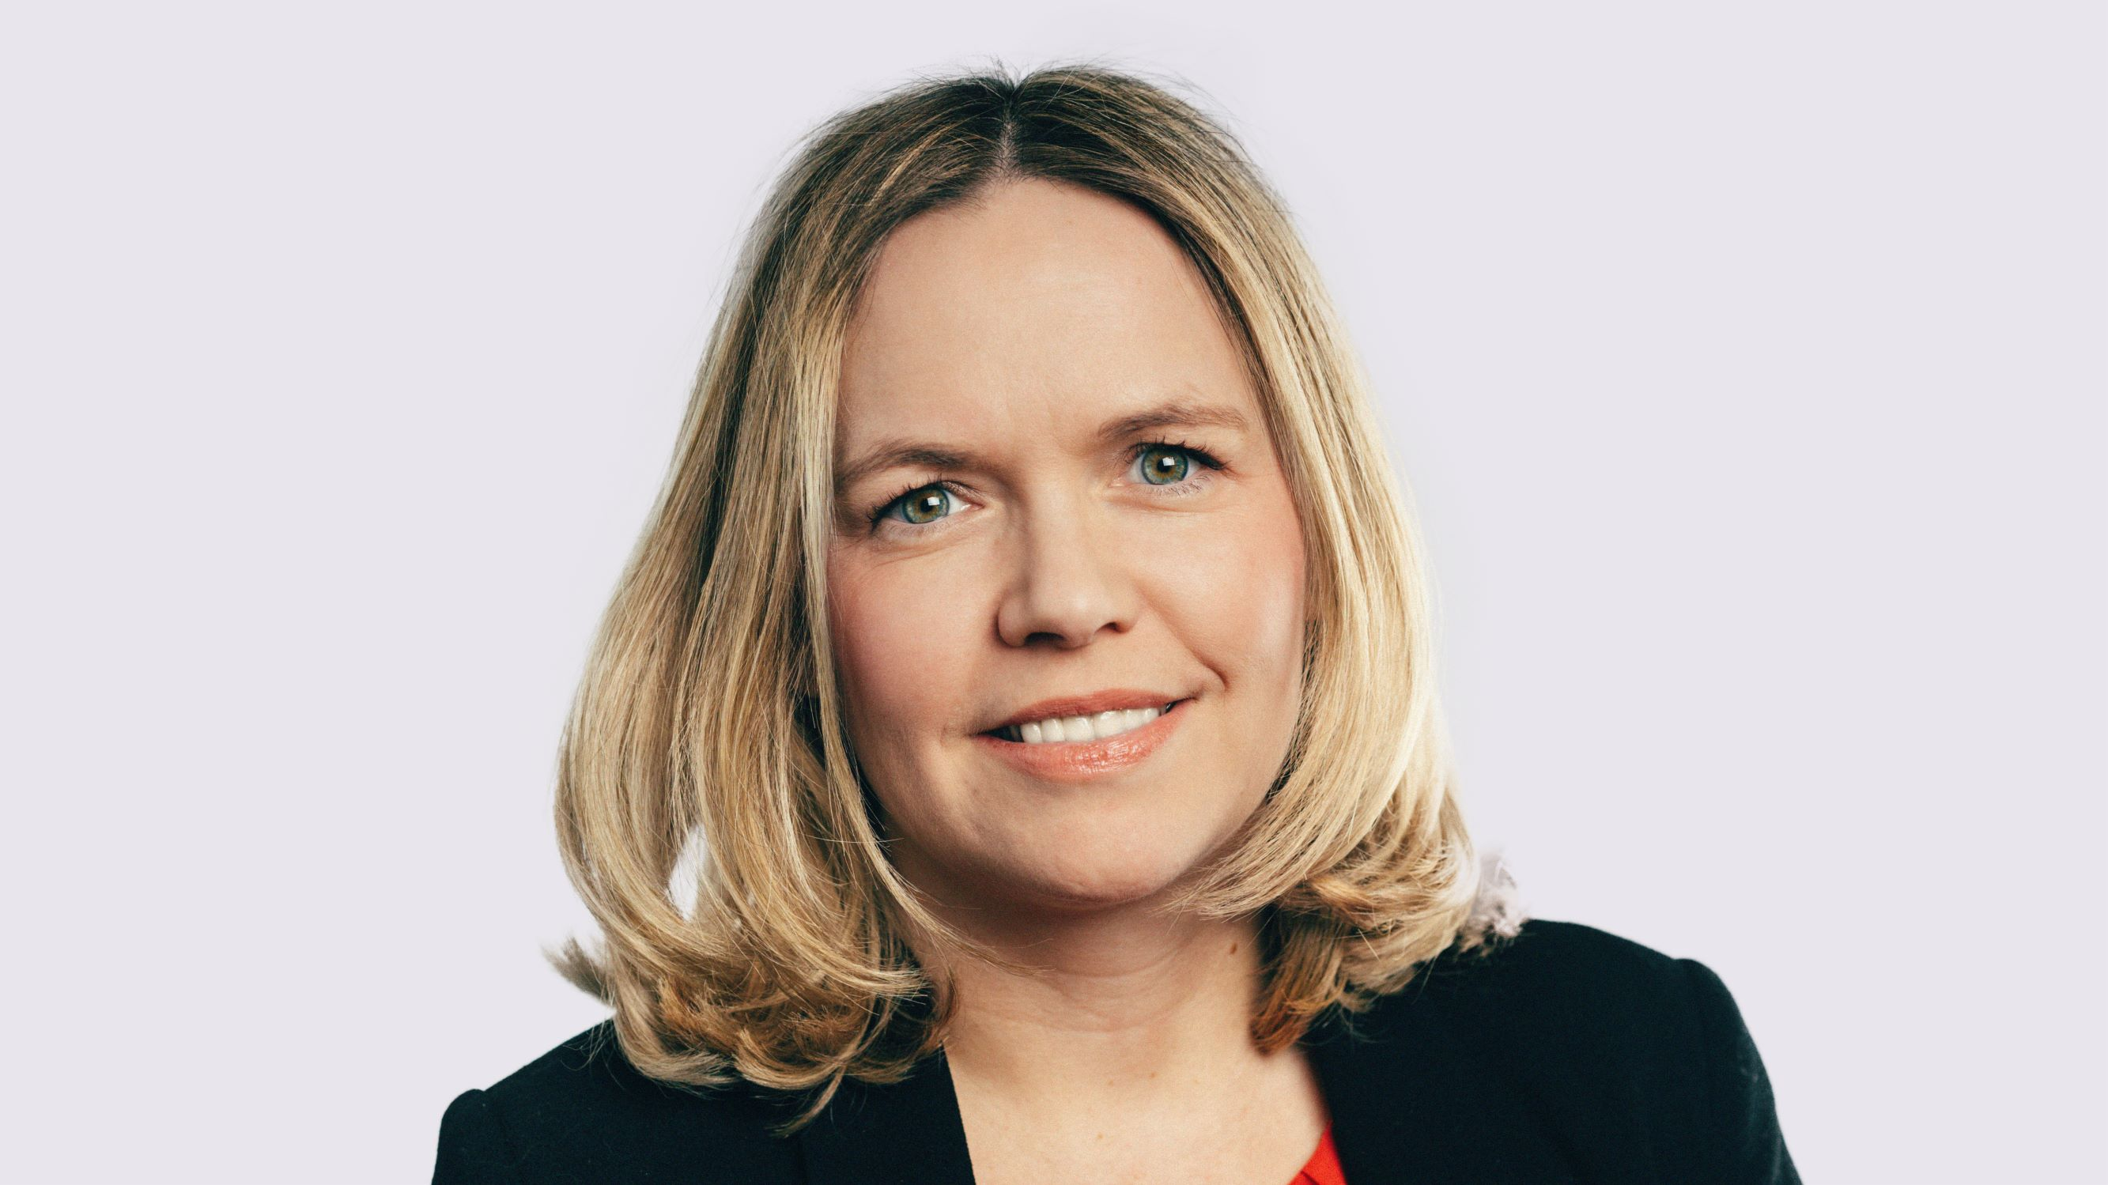




Zoe Wilson
Zoe Wilson
Director of Innovation & Customer Success
Experienced digital leader, with over 15 years experience of working with Microsoft collaborative technologies
5 years experience of growing, managing & leading high-performing technical consulting teams
Technology evangelist, passionate about driving transformation with tech as the enabler
Accessibility champion, advocate for Women in Technology, mentor, Enterprise Careers Adviser to schools, member of the Women in Teams community and active in the MS tech community
Previous Clients
@SharePoint_Zoe / https://www.linkedin.com/in/zoe-wilson-uk/
Notes:
Zoe
I’m the director of innovation and customer success for a partner called Agilisys, who work predominantly with the UK public sector.
My background is in the content and collaboration workloads of Microsoft 365 – I’ve worked with SharePoint for more than 15 years, and with Teams since it was launched 4 years ago. I’ve got a few years experience now of growing and building out large high performing technical teams. I speak at loads of events, mostly online recently but I have done in person ones as well back when we were allowed – and we actually found out an hour or so ago that we’ve also been accepted for Commsverse as well which is awesome. I’m incredibly passionate about accessibility, and one of the things I like to talk about as well as Teams is accessibility features within Microsoft 365. I recently started working as an enterprise careers adviser to schools in my area, which will hopefully help get more people into tech careers. I’m a member of the women in teams community and active in general across the wider MS community. Go follow me on twitter and connect to me on linked in as well ,

Slide 4
Use cases
Responsibilities
Components
Questions
L
C
S
a
Some of the key use-cases for Microsoft Teams and some the key risks it introduces
Where does Microsoft security responsibilities end and yours begin
What Teams features should you secure, how should you do it and what balance you should strike
Our recommendations, followed by any questions you may have
Notes:
Zoe
Ok, so this is the agenda we’re going to cover with you today. What I would say before we dive in is that this is relatively new content that we’re pulling together, so we may seem a little bit rusty – we hope you enjoy it though, and look forward to any questions
We’ll start off by looking Teams today, and some of the key use cases, or the key things that I want from Teams as a end user
We’ll then look at responsibilities for security – whose responsibility is it actually? Ours? Microsoft?
Then Luke is going to walk us through some of the technical components that are available from a security perspective to keep our end-users safe as they work and collaborate within teams.
Finally, we’ll finish off with a bit of a summary, recommendations and time for any questions you may have

Slide 5
Microsoft Teams today
95 million
Microsoft added 95 million users in 2020, as it became one of the most popular apps during the coronavirus pandemic
894%
From March to June 2020, Microsoft Teams noticed 894 percent growth, more than Zoom
30 billion
As of Microsoft Ignite, 30 billion collaboration minutes are taking place each day
500,000
The number of organizations using Teams increased from 50,000 in 2017 to 500,000 in 2020.
29.71%
A study of US Teams users in 2020 found that 29.71% of companies used Microsoft Teams for remote work during the COVID-19 pandemic.
145 million
Microsoft Teams reached 145 million daily active users (DAU)
Notes:
Zoe
COVID
500k Microsoft Teams as their default messaging platform
Microsoft Teams reaches 115 million DAU—plus, a new daily collaboration minutes metric for Microsoft 365 - Microsoft 365 Blog
Microsoft Teams Revenue and Usage Statistics (2021) - Business of Apps
Microsoft Teams usage jumps 50 percent to 115 million daily active users - The Verge
Microsoft Teams Statistics – Tom Talks
Microsoft: Teams is now at 145 million daily active users | ZDNetw

Slide 6
Striking the balance
 | Low Security | High Security
Improved Usability | What users' default to Security incidents likely | Where we want to be
Decreased Usability | Everyone suffers Trouble inbound | Bad security professionals default here User circumvention likely
Usability
Security
Notes:
Zoe
Security vs. usability: Does there have to be a compromise? (techgenix.com)
Historically, often, effective security came at the expense of usability. And usability came at the expense of security. Many continue to go by the notion that there is no way to achieve both effective security and usability simultaneously, that it just does not work.
If you look at this image, where we want to be is that green box on the top right – we want high security, but we also want improved usability as well. I think what I’ve seen with Teams over the last year is that a lot of orgs are in the improved usability low security box, as they just threw Teams out to help people work remotely without actually thinking about it.

Slide 7
What users need
I need to be able to work safely from anywhere
Augmented
Data needs to be protected for me
I need to ensure only the users that should have access have access (internal or external)
Assisted
Autonomous
Notes:
Zoe
Ok, so as a user, what are the types of use-cases I have?
I think the last year has shown that users need to be able to work from anywhere, and actually its not just about working from anywhere, its also working on any device as well. When the whole world shifted to remote work, we saw a few things happen. There were huge device shortages worldwide, so people were having to connect to office apps like Teams using mobile, or tables or old laptops. I need to be able to work from home, on the move or when we’re allowed again , back in the office. I need to be able to work from my bed, or my kitchen table, my desk, wherever I need to.
I also need confidence as a user that only the right people have access to my content, so that I can collaborate safely and securely. It doesn’t matter whether this is with my internal colleagues in an internal team, or with external partners in an external facing team. ~Whether this is me working and collaborating with someone in a Teams meeting, or a chat, or whether they are invited into a team as a fully fledged guest in my environment
When we think that as a user, I also need to be able to collaborate securely with other organisations – this means that I need my IT admins to have set up all the right configuration and controls to allow for me to do work with external people securely.
And lastly, when I think about my data, it needs to be protected – and ideally, it needs to be protected FOR me. A typical end user is not a records manager, I don’t know what different retention rules or sensitivity controls apply – ideally I want to be able to just work in the right team, with my colleagues, and automatically have my data looked after for me.
Luke
Flip side admins thoughts
How do I ensure governance?
Should I enable self-service?
How do I manage groups at scale?

Slide 8
Responsibilities

Slide 9
Shared responsibility model
Responsibility
On-Prem
IaaS
PaaS
SaaS
Data classification
and accountability
Customer management of risk
Data classification and data accountability
Client & end-point
protection
Identity & access
management
Shared management of risk
Identity & access management | End point devices
Application level controls
Network controls
Provider management of risk
Physical | Networking
Host infrastructure
Physical security
Notes:
You’re driving a long, dark road on a rainy night. If you’re driving 20 miles over the speed limit and you don’t step on the brakes when the car in front of you comes to a sudden stop, is it your fault or your car manufacturer’s fault if you rear-end the car that is in front of you?
When we drive, we seamlessly understand that there are some things we depend on the manufacturer to provide (brakes that work, airbags that deploy) and some things we’re responsible for (using the brakes when needed, not turning off the airbag protection).
Slide Objective: Talk about the shared responsibility in compliance world and how it’s a big opportunity for our partners to help the customers.
Talk Track:
When customers leverage only their on-premises IT estate, they have complete responsibility to protect the data and to implement the controls necessary to be compliant with regulatory standards.
And when they move to the cloud services they lessen their burden (sometimes considerably) because the cloud represents a shared responsibility between the customer and the cloud service provider. For example, if you use SaaS like Microsoft 365 or Office 365, Microsoft helps you take care of majority of the controls including physical infrastructure and networking, so customers don’t need to spend resources building their own datacenter or setting up network controls.

Slide 10
Architecture

Slide 11
Key
Microsoft Teams high level architecture
Microsoft Teams
Skype services
Azure and M365
Web
Desktop
iOS
App
Android
App
Microsoft Graph API
Teams
Services
Web
Companions
Settings and
O365 access
Audio / video
Telemetry
Messaging
Notes
Files
Files
Other Workloads
OneNote
WAC
OneDrive for business
SharePoint
Experimentation
Teams services
Chat & Presence services
Calling / Meeting
AAD
Most recent
files
Most Recent
Search
Exchange
Calendar
Bots
PSTN
Extensibility
Stream Recording
Connectors
Exchange + Exchange Online Protection
Notification Hub
Firehose Listener
Email
Service
Notes:
Cloud only – Early on we made a choice for Teams to be cloud only. This significantly contributes to our speed, it ensures our customers have a consistent global experience, and we can take advantage of the vast set of services that exist across Microsoft and from our partners.
Next Generation Skype compliance services – We are using the best enterprise services available for calling and chat.
App hub with chat at its core – Teams is certainly a chat centric service and that is a core aspect to the entire product. We also have a strategy to take the best of Microsoft and bring that into the experience. This is why we take advantage of SharePoint, OneNote, Planner, PowerBI, etc. In some other sessions you will see that we are extending beyond Microsoft as well with a robust ecosystem of integrations and app.
To add some clarity to the diagram
MRU – This is your most recently used files
Teams MT services – Is a set of middle tier micro services
SMTP – is Simple Mail Transfer Protocol – Used for sending emails to our users for things like notifications
Notification hub is for notifications to mobile devices

Slide 12
Technical components

Slide 13






Azure AD Conditional Access
Conditions
Actions
Microsoft Azure
Location (IP range/GPS)
Device state
Allow
Enforce MFA
Session control
User
User group or type
Risk
Block access
Wipe device
On-premises
applications
MFA
Risk (Low, Medium, High)
Azure Active Directory Premium
Microsoft Intune
Microsoft Intelligent
Security Graph

Slide 14
Microsoft Identity Protection
Anonymous IP address
Microsoft analyses 6.5 trillion signals per day to identify and protect customers from threats.
Microsoft uses these signals to classify the risk of a sign in
The risk signals can feed into tools such as Conditional Access or Sentinel to trigger remediation or further investigation
d
Password
spray
Unfamiliar
sign-in properties
A
01
02
b
Diagram Charts
06
Sed maximus aliquam dolor.
03
C
J
Malware linked
IP address
Leaked
credentials
05
04
W
Atypical travel
Notes:
Identity Protection is a tool that allows organizations to accomplish three key tasks:
Automate the detection and remediation of identity-based risks.
Investigate risks using data in the portal.
Export risk detection data to third-party utilities for further analysis
What is Azure Active Directory Identity Protection? | Microsoft Docs
Identity Protection categorizes risk into three tiers: low, medium, and high.

Slide 15
Risk based Conditional Access use case
Conditions
Actions
Microsoft Azure
Location (IP range)
Device state
Allow
Enforce MFA
Remediate
Password reset
User
User group
Risk
Block access
Password reset
On-premises
applications
MFA
Risk (Low, Medium, High)
Notes:
Most users have a normal behavior that can be tracked, when they fall outside of this norm it could be risky to allow them to just sign in. You may want to block that user or maybe just ask them to perform multi-factor authentication to prove that they are really who they say they are.
A sign-in risk represents the probability that a given authentication request isn't authorized by the identity owner. Organizations with Azure AD Premium P2 licenses can create Conditional Access policies incorporating Azure AD Identity Protection sign-in risk detections.
Azure AD Identity Protection sign-in risk detections.

Slide 16
Azure AD Conditional Access recommendations
u
v
e
b
Enable MFA
Disable legacy auth
Allow or block countries
Use device controls
By using MFA, the likelihood of a successful account breach is reduced by 99.9%.
There should be no question whether to adopt MFA in your environment or not. All identities should be
protected by MFA in some shape, way, or form!
Legacy authentication makes it easier for attackers armed with today’s tools and methods to capture users’ credentials (particularly if not TLS protected)
By allowing or blocking countries we can easily cut out volumes of undesired authentication attempts
Prevent downloads on unmanaged devices
Enforce device compliance
Use device management as another factor of authentication
Notes:
Security Defaults
Will be enabled by default for new tenants. Blocks basic authentication, Requires MFA for admin accounts, requires users to register for MFA and applies account protection.
Security defaults are ideal for organizations using the free version of Azure Active Directory. This way their services are still protected although conditional access is normally not part of the free version of Azure Active Directory. Security Defaults can only be used when no custom conditional access or identity protection policies are created in the Azure AD tenant
MFA
Do users need to use MFA for every authentication attempt?
Do you need MFA for every authentication attempt or only when accessing certain data or when using an untrusted endpoint (device)
Do we have trusted networks where no MFA is required? For example, when 802.1x is used to connect to a corporate network; do you still require MFA when connected to that network? Or perhaps less frequently?
Zoe to ask question on how this keeps me safe working from anywhere and how this may change my user experience

Slide 17
Azure AD Access Reviews
Azure Active Directory (Azure AD) access reviews enable organizations to efficiently manage group memberships, access to enterprise applications, and role assignments. User's access can be reviewed on a regular basis to make sure only the right people have continued access.
Can be nominated, managers or self review
The system can make recommendations based on usage
Create an access review
Reviewers give feedback
Results applied – access renewed or removed
Review audit reports
Notes:
AAD P2 / E5 / EMS E5

Slide 18

Azure AD Entitlement Management
Azure Active Directory (Azure AD) entitlement management is an identity governance feature that enables organisations to manage identity and access lifecycle at scale, by automating access request workflows, access assignments, reviews, and expiration.
Can manage access packages to Teams, M365 Groups, SharePoint sites, and applications
Can be used for internal users and guests
Resource access scoped to specific users
Users removed after business need ends
Ongoing auditing and reporting
User request
Access reviewed and revised
Access approved and provisioned
Notes:
AAD P2 / E5 / EMS E5
Employees in organizations need access to various groups, applications, and sites to perform their job. Managing this access is challenging, as requirements change - new applications are added or users need additional access rights. This scenario gets more complicated when you collaborate with outside organizations - you may not know who in the other organization needs access to your organization's resources, and they won't know what applications, groups, or sites your organization is using.
Enterprise organizations often face challenges when managing employee access to resources such as:
Users may not know what access they should have, and even if they do, they may have difficulty locating the right individuals to approve their access
Once users find and receive access to a resource, they may hold on to access longer than is required for business purposes
These problems are compounded for users who need access from another organization, such as external users that are from supply chain organizations or other business partners. For example:
No one person may know all of the specific individuals in other organization's directories to be able to invite them
Even if they were able to invite these users, no one in that organization may remember to manage all of the users' access consistently
What is entitlement management? - Azure AD | Microsoft Docs

Slide 19
M365 Groups – group creation
Benefits
Allows control over creation of M365 groups within an organization
Governance controls and settings can be applied at time
Can incorporate a provisioning process with business logic or specific groups
Recommendations
Might not be suitable for all organisations
Can help supplement orgs without the higher licences
Notes:
Zoe – point on group creation. Coming back to my earlier point:
confidence as a user that only the right people have access to my content, so that I can collaborate safely and securely. It doesn’t matter whether this is with my internal colleagues in an internal team, or with external partners in an external facing team. ~Whether this is me working and collaborating with someone in a Teams meeting, or a chat, or whether they are invited into a team as a fully fledged guest in my environment
If Teams self-service is switched on, then that means that any Team could be turned into an external team, which is way too scary in my view from a compliance and security perspective
The way we typically deal with this for our colleagues and customers is to use a provisioning solution. Typically depending on budget, we either use a self-built power platform tool, or we implement AvePoint Cloud Governance. The way we typically recommend dealing with this is leaving internal teams as self-service – so requests are still made via our provisioning tool, but no approval is needed, and the team is set up with the ability to have guests turned off.
Then we build on this with an approval process for external teams, to make sure that there are some controls in place to minimise the risk of guests inadvertently being brought into internal only Teams! Again, the users shouldn’t have to think about it, we need to make it easy for them.

Slide 20




M365 Groups - guest access
04
Group assignments
Enables safe teamwork outside the organization
Works with any email addresses
Based on common Azure B2B platform
Govern using built in M365 tools
03
For external users
02
Enable guest access today
01
Notes:
Enable guest access if you haven’t already!
Use guest access when you are working with individuals outside your organization
Govern using allow/block guest domains, guest settings on each group, guest inviter role, access review and sensitivity labels
Use Entitlement Management to avoid repetition

Slide 21
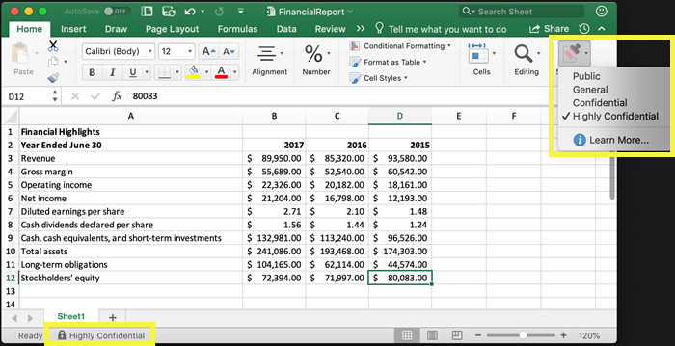
Sensitivity Labels – Document level
What is a sensitivity label?
Tag that is customizable,
in cleartext,
and persistent.
It becomes the basis for applying and enforcing data protection policies.
Sensitivity labels can now be applied at the document, groups & sites and within Azure Purview
Double Key Encryption is an E5 feature which uses Sensitivity labels to protect content

Slide 22
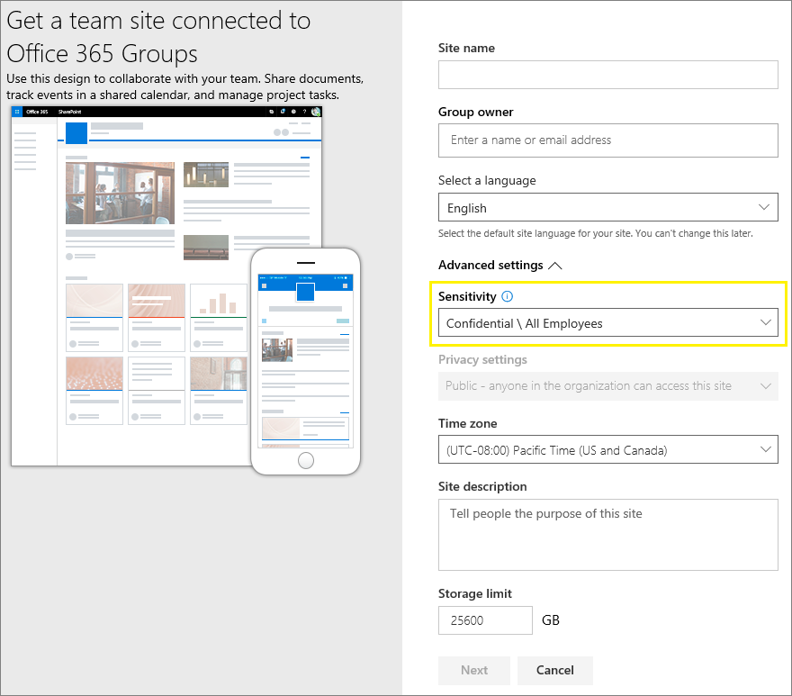
Sensitivity Labels – Container level
In addition to using sensitivity labels to classify and protect documents and emails, you can also use sensitivity labels to protect content in the following containers: Microsoft Teams sites, Microsoft 365 groups and SharePoint sites. For this container-level classification and protection, use the following label settings:
Privacy (public or private) of teams sites and Microsoft 365 groups
External user access
External sharing from SharePoint sites
Access from unmanaged devices
Notes:
Automatically enforce policies on Groups through labels
Labels help you classify Groups across your organization
Create different labels for Documents and Groups
Changes made to label settings will be automatically reflected on Groups

Slide 23
Sensitivity Labels – Recommendations
Migrate existing Azure Information Protection labels to sensitivity labels
Configure a baseline sensitivity label policy for both item and container level
Create different labels for Documents and Groups
If using default labels, review label descriptions and settings
Restrict who can create public and external groups by publishing appropriate labels
Scope rollout to a pilot group
Train the team owners and members on how to use the team, the underlying SharePoint site, and the sensitivity label for the team
Conduct periodic reviews of team and label usage
Retrain team owners and members as needed

Slide 24
Data Loss Prevention (DLP)
Detect
Protect
Monitor
Easily create policies that find sensitive content wherever it lies in Microsoft 365
Stop accidental sharing and educate users
Get visibility into how your data is being protected
Notes:
Can block and encrypt content

Slide 25
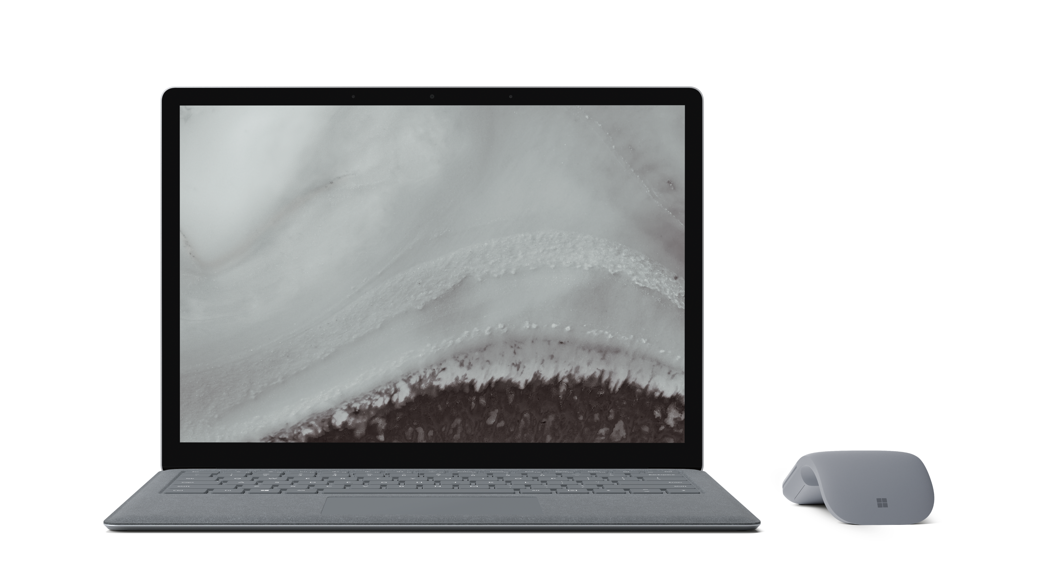
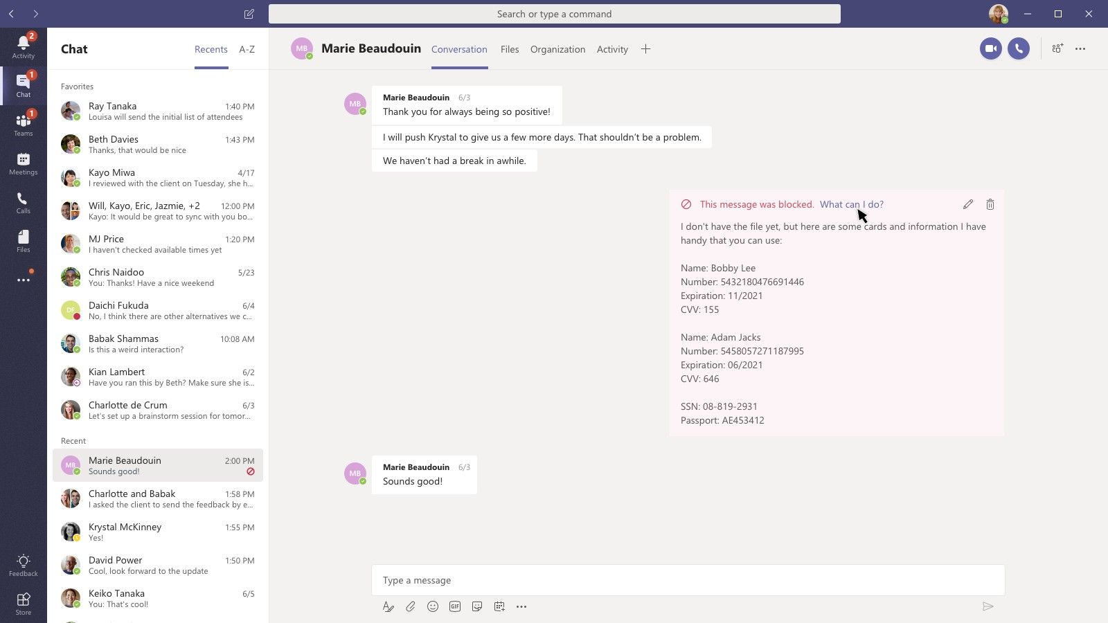
Data Loss Prevention for Microsoft Teams
Automatically block messages which contain sensitive information
Educate and guide end-users with notifications and “policy tips”
Unified classification engine supporting 90+ sensitive information types and custom sensitive info type creation

Slide 26
Data Loss Prevention for Endpoint
Microsoft 365 Endpoint DLP
upload to cloud service, or access by unallowed browsers
copy to network share/ removal USB media
copy via Bluetooth
print out a document
copy over a remote session
copy to other app
Endpoint data loss prevention (Endpoint DLP) extends the activity monitoring and protection capabilities of DLP to sensitive items that are on Windows 10 devices.
Actions shown are auditable and restrict able.
No client needed if using Microsoft Defender for Endpoint. Endpoints will be ready to configure
Notes:
Luke
Zoe to ask a question about BYOD endpoint protection, and how we secure contractors, people on own machines

Slide 27
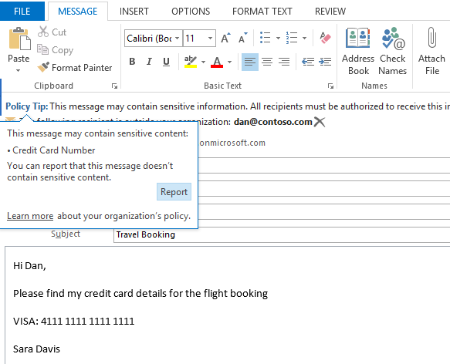
Data loss prevention - recommendations
Recommend to setup two baseline policies DLP for
U.K. Financial Data
U.K. Data Protection Act
U.K. Access to Medical Reports Act
U.K. Privacy and Electronic Communications Regulations
U.K. Personally Identifiable Information (PII) Data
U.K. Personal Information Online Code of Practice (PIOCP)
General Data Protection Regulation (GDPR)
Notes:
Recommend to setup with policy tips and email notifications to users
Recommend also to send an email across to the information security team
Under 10 items
Over 10 items

Slide 28
Any questions
Thanks for
listening
Notes:
Its clear that the tools do exist for IT to keep our users safe while they work, and that organisations – not Microsoft – have the responsibility to configure them inline with org policies, to keep our users safe
You CAN balance usability with security, to let your users use Teams to their hearts content, but in a way that keeps them safe. Or to put it another way – you can have your cake and eat it.
However – there is a catch. It does come with a price! Typically you either need individual add on licenses for some of these components, or to get the best experience, you really need to start going to a full fat E5 license.

Slide 29
M365 Groups - expiration policy
Benefits
Auto-renewal of groups based on user activity
Expire inactive groups older than a specific period
Group owners get emails/ app notifications to take renew
Can set expiration policy to specific groups
Expired groups can be restored within 30 days
Recommendations
Pilot with specific groups initially and review Audit Logs for auto-renewed groups
Choose inactive groups based on the activity report in Microsoft Admin center
Onboard your helpdesk team and communicate renewal process to group owners
Ensure groups have multiple owners & configure email for ownerless groups
Notes:
AAD P2 / E5 / EMS E5

